Slide 1
Convolutional Neural Networks Team Project
Summer 2021

Slide 2
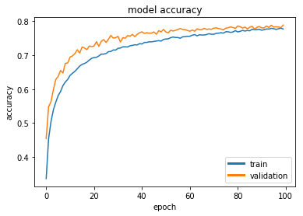
Neural Network Team Task
Team Task: build a Neural Network Model (NN) to recognize objects in images
Training Data and the basic structure of the NN model are provided
Students need to try different model structures/parameters and settings in order to have the best model performance
Assessment of performance: accuracy on testing data set

Slide 3
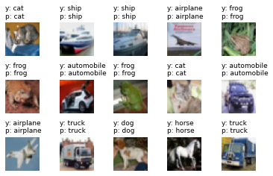
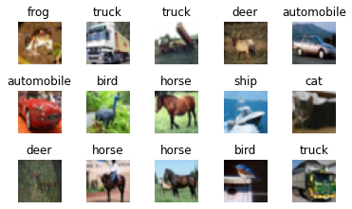
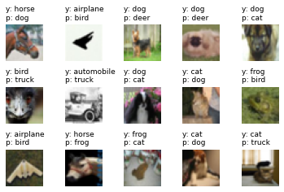
Neural Network Team Task
Training Data
right
wrong

Slide 4
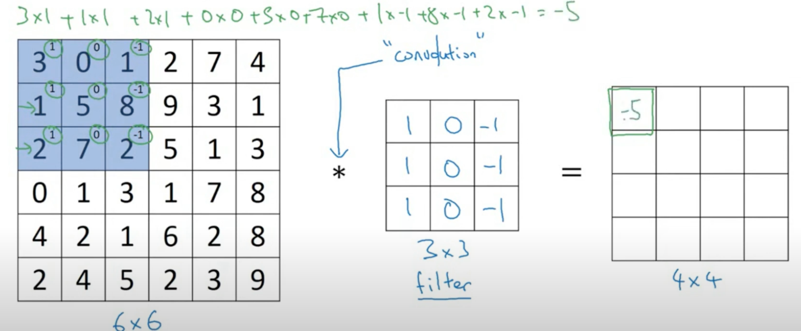
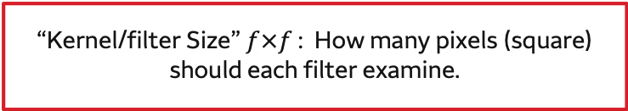
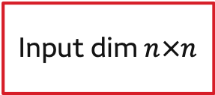
A Revisit of Convolutional Neural Networks
Recommended Video: https://www.youtube.com/watch?v=0MTaMxGhSws
Convolution Calculation:$n×n$ * $f×f$ = $(n−f+1) ×(n−f+1)$
Input dim $n×n$
model.add(Conv2D(1, 3, 1, input_shape=(6, 6, 1), padding='same', activation='relu'))
Number of Filters
“Kernel/filter Size” $f×f$ : How many pixels (square) should each filter examine.

Slide 5
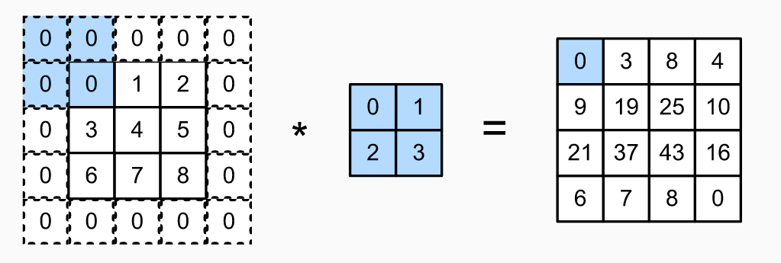
A Revisit of Convolutional Neural Networks
Padding:$n×n$ * $f×f$ with p = $(n+2p−f+1) ×(n+2p−f+1)$
Same Padding: pad so that output size is the same as the input size
model.add(Conv2D(64, 8, 8, input_shape=(64, 64, 1), padding='same', activation='relu'))

Slide 6
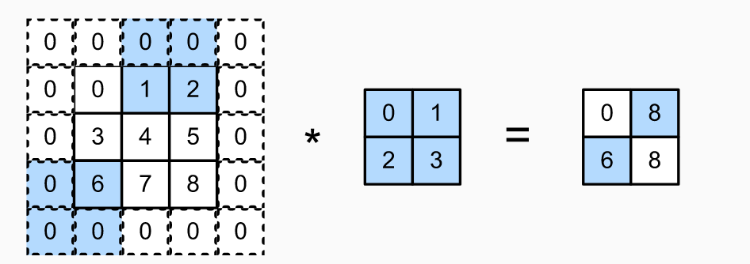
A Revisit of Convolutional Neural Networks
Stride: $\frac{n+2p−f}{S}+1, S \text{= }\text{How} \text{many} \text{pixels} \text{to} \text{slide} \text{the} \text{filter} \text{at} \text{each} \text{step}\text{.}$
“Stride”: How many pixels to slide the filter at each step.
model.add(Conv2D(64, 8, 8, input_shape=(64, 64, 1), padding='same', activation='relu'))

Slide 7
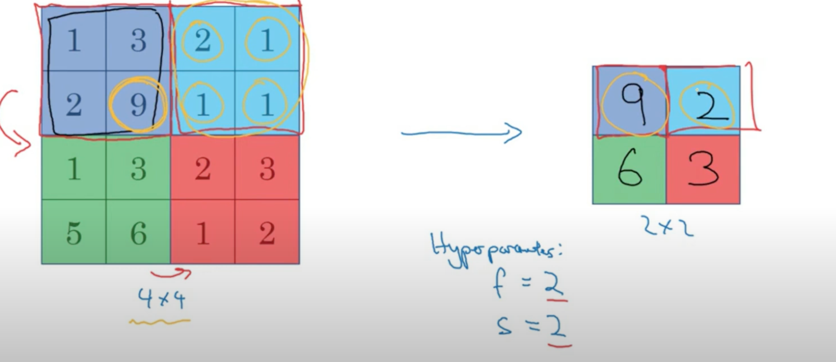
A Revisit of Max Pooling
model.add(MaxPooling2D(pool_size=(2, 2)))

Slide 8
Review: Convolutional Layers In Keras
“Kernel_Size”: How many pixels (square) should each filter examine.
## Convolutional Layer
model.add(Conv2D(64, 8, 8, input_shape=(64, 64, 1), padding='same', activation='relu'))
## Pooling Layer
model.add(MaxPooling2D(pool_size=(2, 2)))
“Stride”: How many pixels to slide the filter at each step.
Number of Filters
Size of the Region to pool
Warning: Making sure that dimensions make sense can be more challenging convolutional networks than in feed forward.

Slide 9
A Revisit of Convolutional Neural Networks
Convolutional layers, which use the same weights on sliding windows across the entire image
Can be viewed as a set of filters, which have been trained to recognize certain structures in the image
“Examine” what’s in a particular window of the image
Weights are fixed no matter which part of the image they are examining
Each filter is to see some type of visual feature, such as the edge of some orientation or a blotch of some color, or eventually entire honeycomb or wheel-like patterns
right

Slide 10
Convolutional Neural Networks Pooling Layers
Pooling layers, where output from earlier layers is combined and reduced
Used to progressively reduce the spatial size of the representation to reduce the amount of parameters and computation in the network
Hence, it controls overfitting
Two types include “max pooling” and “average pooling,” which select the maximum or average value, respectively, of activations over an area of the image, rather than every activation

Slide 11
Convolutional Neural Networks Layers
These layers provide at least two benefits:
Provide a way to recognize signals (and therefore objects) no matter where they are located in the image
Reduce the total number of weights learned in the network, improving training

Slide 12
Students: you can try different optimizers, batch sizes and epoch numbers!
Choose an optimizer.
Good bets: ‘adam,’ ‘sgd’
Define an appropriate loss function for your response:
‘binary_crossentropy’ for binary ‘mean_squared_error’ for continuous
## Compile the model
model.compile(optimizer='sgd', loss='binary_crossentropy', metrics=['acc'])
## Fit the model
hst = nn_new.fit(x, y, batch_size=50, epochs=250, verbose=0)
Nature of processing updates. Change to 1 for exciting updates!
The data: first predictors, then response
Batch Size: Number of observations to look at at a time
Epochs: How many times to look at the entire data set.

